Slide 1


INTRODUCTION TO FRACTALS BML Munjal University
Project Work Presentation: Generating Fractal Reptiles With Holes
Team-01
Indradhar Paka
Kosana Sai Venkata Pavan Kumar

Slide 2
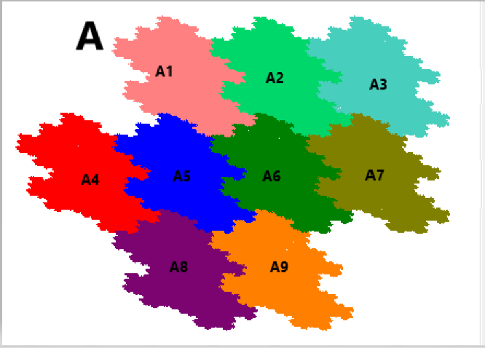
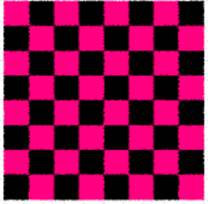
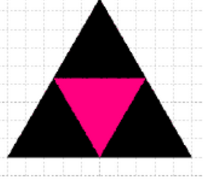
Introduction: Fractal Reptiles
A closed bounded set A with non-empty interior in plane or space is called an m-reptile if there are sets A1, A2, ..., Am congruent to A, such that different sets Ak, Aj have no common interior points, and the union gives A.
A = A1 ∪... ∪ Am

Slide 3

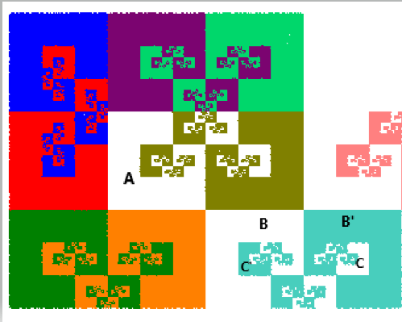
Fractal Reptiles with holes:
A reptile(T) has a hole if the complement of the closure of some component of the interior of T has a bounded component.
Interpretation: There is a compliment segment available to a missing segment in the reptile. This compliment component is bounded.

Slide 4

Background
Hausdorff distance: For any A, B ∈ H(X), distance between A and B is given by h(A, B) = max{d(A, B), d(B,A)}
Fixed Points: The points which does not change during transformation between iterations.
IFS: finite set of contraction mappings wk: X → X, having contractivity factors sk,
Attractor of IFS: The set of fixed points for the iterator which would remain during infinite-th iteration.

Slide 5

Background
Similitude of IFS: $f_{i}\left(x\right)=\frac{1}{\sqrt[d]{n}}R_{i}x+d_{i}, i=1,……,n,$
Union and overlap of Tailing: A tiling of the plane is a countable family Ai of compact sets that covers the plane with int(Ai) ∩ int(Aj ) ≠ ∅ for i ≠ j. Thus, the interior of each set does not intersect the interior of any other set, i.e., the tiling will have no overlap.

Slide 6

Method: Fractal Rep Tile with holes
A reptile has a hole if the complement of the closure of some component of the interior of T has a bounded component.
For every n-reptile, where n>=4 a fractal reptile with hole can be generated.
Let |m|=n/2 and spanned over negative and positive integers for the below equations and the IFS are mentioned below. where R(θ) is the rotation through the angle θ and σy denotes the reflection about the y-axis.
$f_{i}\left(x\right)=\left\{\begin{aligned}\frac{1}{\sqrt{n}}R\left(\frac{π}{2}\right)\left(x\right)+\left(i+\frac{1}{2},0\right), −m≤i≤−1 \\ \frac{1}{\sqrt{n}}R\left(−\frac{π}{2}\right)\left(x\right)+\left(i+\frac{1}{2},0\right) 0≤i≤m−2,\end{aligned}\right.$
$g\left(x\right)+\left(−m+\frac{1}{2},0\right)$

Slide 7

9-Rep Tile with a Hole:
A0 = [−3,3] × [−3/2,3/2] and ρ = 1/3
$$f_{i}\left(x\right)=\left\{\begin{aligned}ρR\left(\frac{1}{2}π\right)\left(x\right)+d_{i}, i=1 \\ ρR\left(\frac{1}{2}π\right)\left(x\right)σ_{y}\left(x\right)+d_{i}, i=2 \\ ρx+d_{i}, i=3,4 \\ ρσ_{y}(x)+d_{i}, i=5,6 \\ ρσ_{y}(x)+d_{i}, i=7 \\ ρR(π)(x)+d_{i}, i=8,9\end{aligned}\right\}$$

Slide 8

16-Rep Tile with Holes:
A0 = [−4,4] × [−2,2] and ρ = ¼
$$f_{i}\left(x\right)=\left\{\begin{aligned}ρR\left(\frac{1}{2}π\right)\left(x\right)+d_{i}, 1≤i≤5, \\ ρR\left(\frac{1}{2}π\right)σ_{y}\left(x\right)+d_{i}, 6≤i≤10, \\ ρx+d_{i}, i=11,12, \\ ρσ_{y}(x)+d_{i}, i=13,14, \\ ρR\left(\frac{1}{2}π\right)\left(x\right)+d_{i}, i=15, \\ ρR\left(−\frac{1}{2}π\right)\left(x\right)+d_{i}, i=16,\end{aligned}\right\}$$

Slide 9
Conclusion and Future Scope
N-Reptiles with holes can be generated for all N>=4.
The Holes inside may be countable or uncountable.
The creation of IFS for the reptiles is the most important step.
There can be 3D reptiles with holes, but our project is confined to 2D reptiles only.
All the reptiles mentioned in this paper are made with reflection of tiles, but researches is being done for creating n-reptiles with holes without the reflections.

Slide 10
References
Christoph Bandt, Dmitry Mekhontsev and Andrei Tetenov, A single fractal pinwheel tile, Proc. Amer. Math. Soc. 146 (2018), 1271–1285.
Husain, Akhlaq, et al. "Fractal rep tiles of ℝ2 and ℝ3 using integer matrices." Fractals (2020).
Christoph Bandt and Dmitry Mekhontsev, Elementary fractal geometry. New relatives of the Sierpinski gasket, ´ Chaos 28 063104 (2018).
Dmitry Mekhontsev, IFStile v1.7.4.4 (2018), http://ifstile.com
Branko Grunbaum and G.C. Shephard, ¨ Patterns and Tilings, Freeman, New York, 1987.
Jordan, F., & Ngai, S. M. (2005). Reptiles with holes. Proceedings of the Edinburgh Mathematical Society, 48(3), 651-671.

Slide 11

Acknowledgement
To: Prof. Dr. Akhlaq Husain
Thank you for all that you did for us in learning the concepts of Fractals in these difficult days! We really enjoyed your class and was excited to come to class every day. We are very thankful for passionate professors like you! Thank you for a wonderful semester.
From: Group-01

Slide 12
Thank You

